Slide 1
Fundamental Electronics (Spring 2015)
17.02.2015
Prof. Martino Poggio
Universität Basel

Slide 2
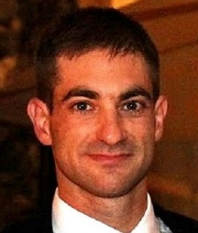
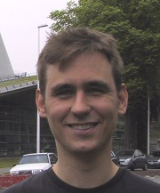
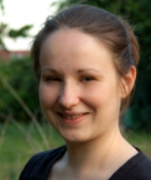
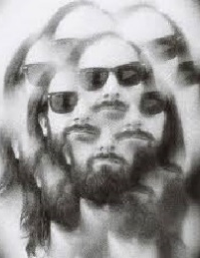
People
Course Leader/Lectures:
Martino Poggio
Teaching Assistant/Exercises:
Floris Braakman
Teaching Assistant/Labs:
Andrea Mehlin
Teaching Assistant/Labs:
Nicola Rossi

Slide 3
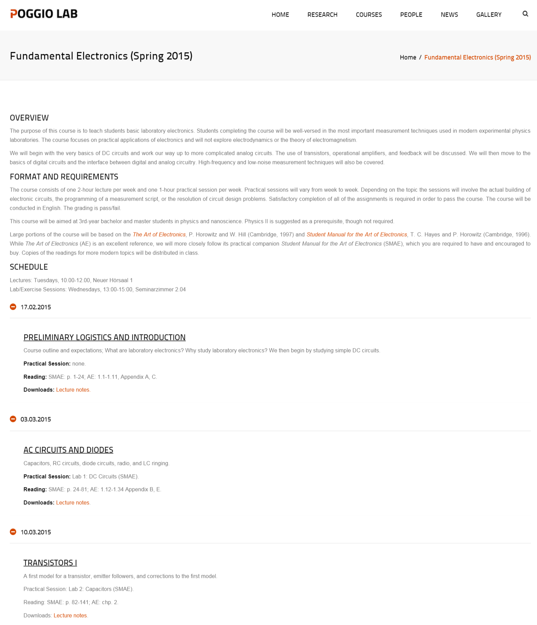
Website
https://poggiolab.unibas.ch/courses/fundamental-electronics-spring-2015/
Overview
Format and Requirements
Schedule
Lecture contecnt
Practical session
Reading
Downloads

Slide 4
Preliminary Logistics and Introduction
Course outline
Expectations
What kind of electronics will we cover?
Why?

Slide 5
Format and Requirements
Language: English
Prerequisites: None
Lectures: 10-12 on Tue. (17.02-26.05.2015), Neuer Hörsaal 1
Exercise Sessions: 13-15 on Wed., 2.04
Assignments: labs, exercises, and reading
No Final paper or Exam
Grading: Pass/fail

Slide 6
What will we cover and why?
The purpose of this course is to give you enough background with electronics to do useful work in a physics laboratory.

Slide 7
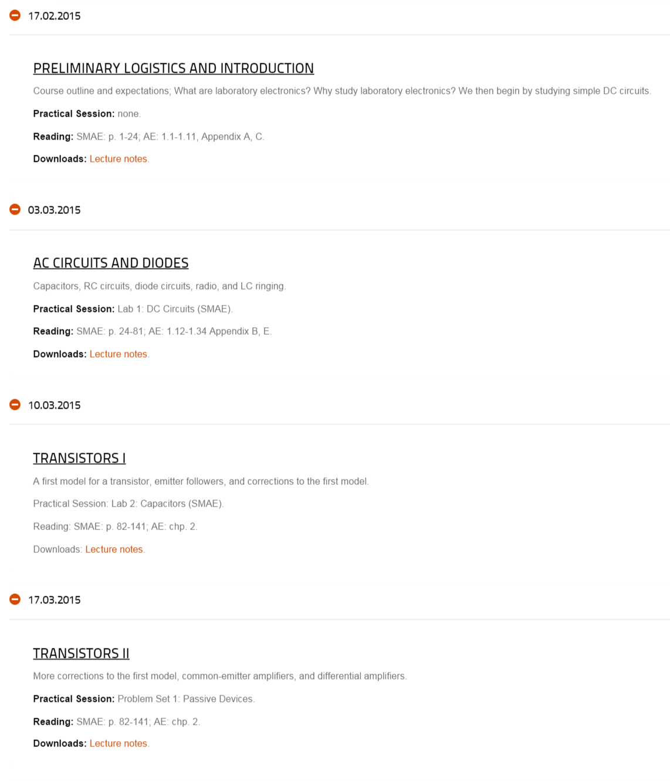

Slide 8
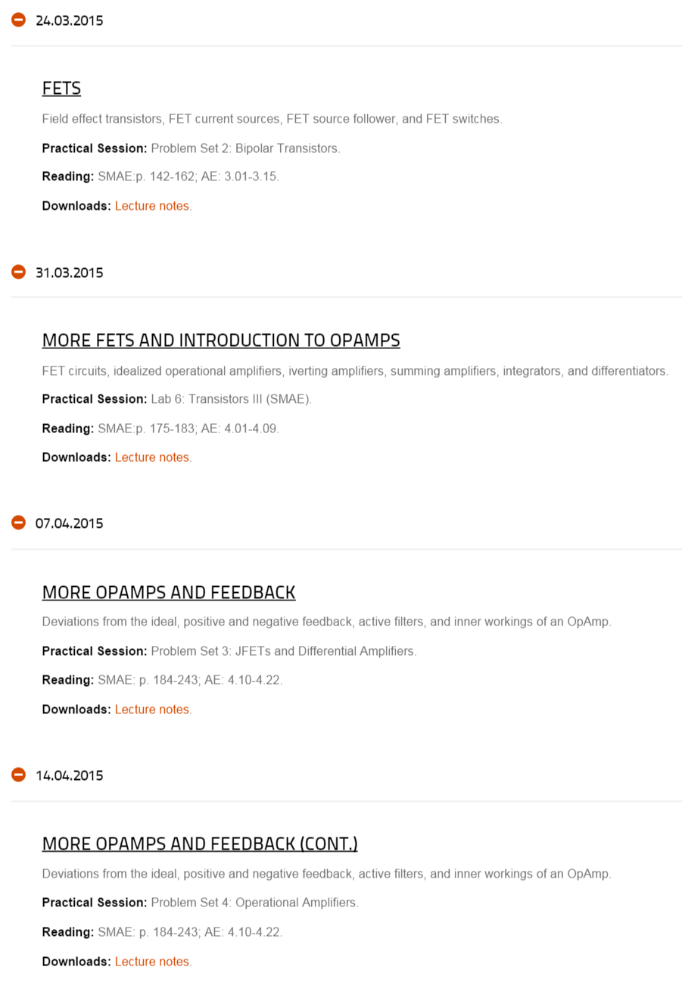

Slide 9
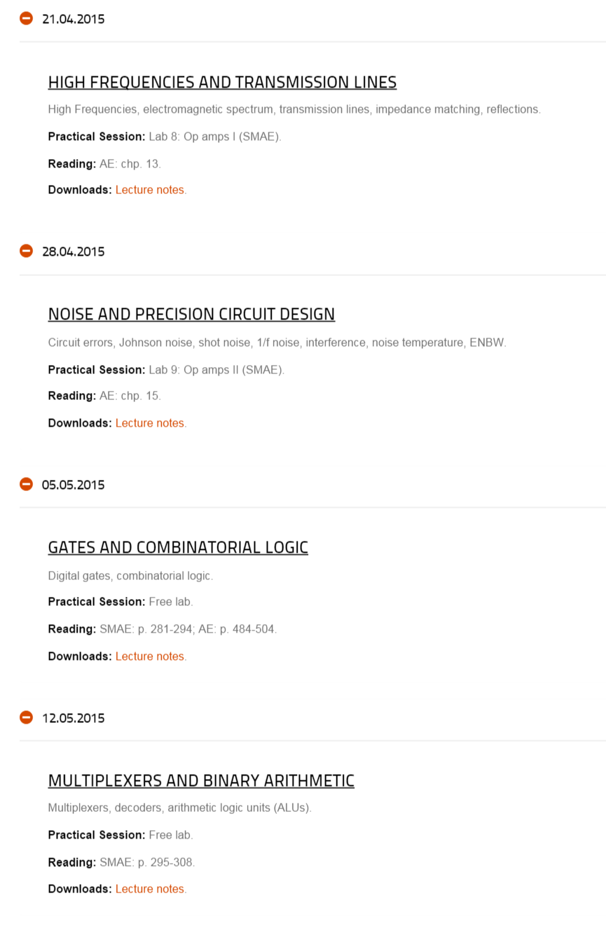

Slide 10
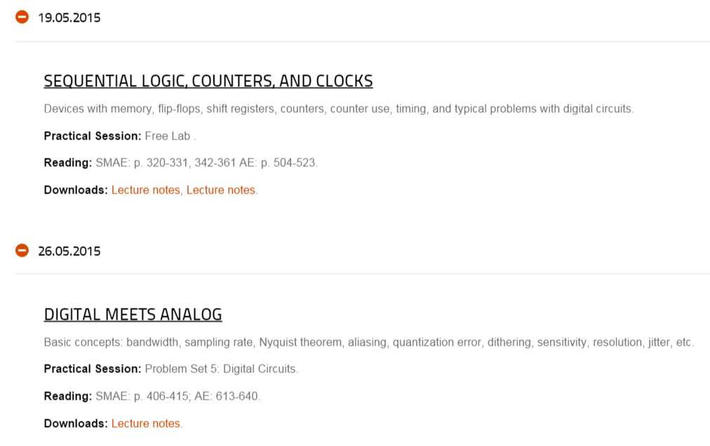

Slide 11
Books
The Art of Electronics, P. Horowitz and W. Hill (Cambridge, 1997).
58.95 EUR on Amazon.de
Student Manual for the Art of Electronics, T. C. Hayes and P. Horowitz (Cambridge, 1996).
36.95 EUR on Amazon.de

