Slide 1
Mechanics of Nanowires
Introduction to Nanomechanics - Fall 2020

Slide 2
Experimental Setup
$$S_{F}=4 k_{B}TΓ$$
$$Γ=\frac{mω_{0}}{Q}$$
$$\frac{dE}{dt}=−Γ{\dot{x}}^{2}$$
$$m∝wtl$$
$$ω_{0}∝\frac{t}{l^{2}}$$
$$Q∝t$$
$$Γ∝\frac{wt}{l}$$
Scale all lengths by $β$:
$$Γ∝β$$
$ω_{0}∝β^{−1}$
100 µm
Notes:
Si cantilever length 120µm (paddle 95µm, mass loaded 18µm) width 3µm-4µm (paddle 10µm, mass loaded 4µm) thickness 111nm-148nm (mass loaded 1.5µm)
ultrasensitive, thermally limited detector (=force sensor) = measure only forces that are larger than thermal force noise (which we know from the fluctuation(S_F)-dissipation(Gamma) theorem)
what makes a good sensor w/ better sensitivity? → ruled by temp T and mech properties Gamma

Slide 3
Amplitude measurement:
$$F_{min}=\sqrt{4 k_{B}TΓ}∝\sqrt{\frac{wt}{l}}∝β^{1/2}$$
$$τ_{min}=l_{e}\sqrt{4 k_{B}TΓ}∝\sqrt{wtl}∝β^{3/2}$$
Frequency measurement:
$${\left(\frac{∂F}{∂x}\right)}_{min}=\frac{1}{x_{osc}}\sqrt{4 k_{B}TΓ}∝\frac{wt^{2}}{l^{2}}∝β$$
$$x_{th}=\sqrt{\frac{k_{B}T}{m{ω_{0}}^{2}}}∝\sqrt{\frac{l^{3}}{wt^{3}}}∝β^{−1/2}$$
$${\left(\frac{∂τ}{∂θ}\right)}_{min}=\frac{l_{e}}{θ_{osc}}\sqrt{4 k_{B}TΓ}∝wt^{2}∝β^{3}$$
2 µm
Notes:
Si cantilever length 120µm (paddle 95µm, mass loaded 18µm) width 3µm-4µm (paddle 10µm, mass loaded 4µm) thickness 111nm-148nm (mass loaded 1.5µm)
ultrasensitive, thermally limited detector (=force sensor) = measure only forces that are larger than thermal force noise (which we know from the fluctuation(S_F)-dissipation(Gamma) theorem)
what makes a good sensor w/ better sensitivity? → ruled by temp T and mech properties Gamma

Slide 4

MBE-grown GaAs/AlGaAs nanowires

Slide 5
MBE-grown GaAs/AlGaAs nanowires

Slide 6

Linear Response
Equation of motion
$$\ddot{x}(t)+γ\dot{x}(t)+{ω_{0}}^{2}x(t)=F(t)$$

Slide 7
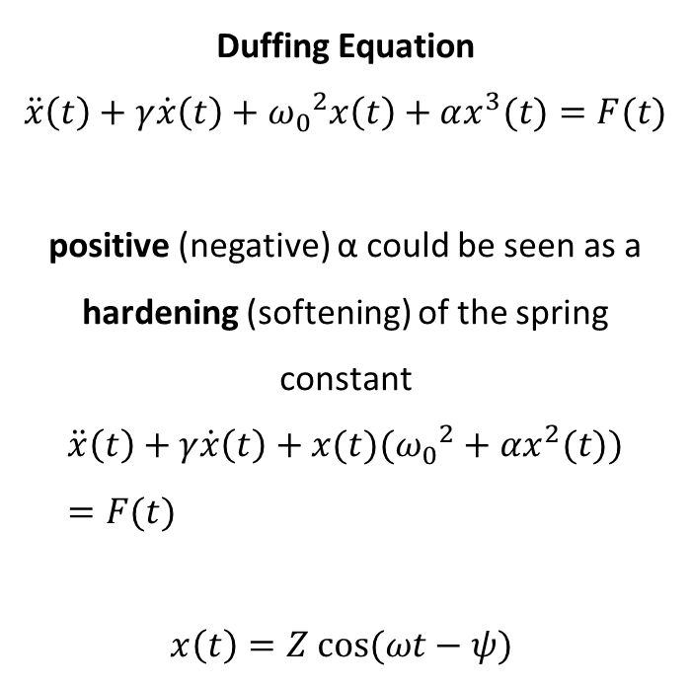
Duffing Oscillator
Duffing Equation
$$\ddot{x}\left(t\right)+γ\dot{x}\left(t\right)+{ω_{0}}^{2}x\left(t\right)+αx^{3}(t)=F(t)$$
positive (negative) α could be seen as a hardening (softening) of the spring constant
$$\ddot{x}\left(t\right)+γ\dot{x}\left(t\right)+x(t)({ω_{0}}^{2}+αx^{2}(t))=F(t)$$
$$x\left(t\right)=Z cos⁡(ωt−ψ)$$

Slide 8
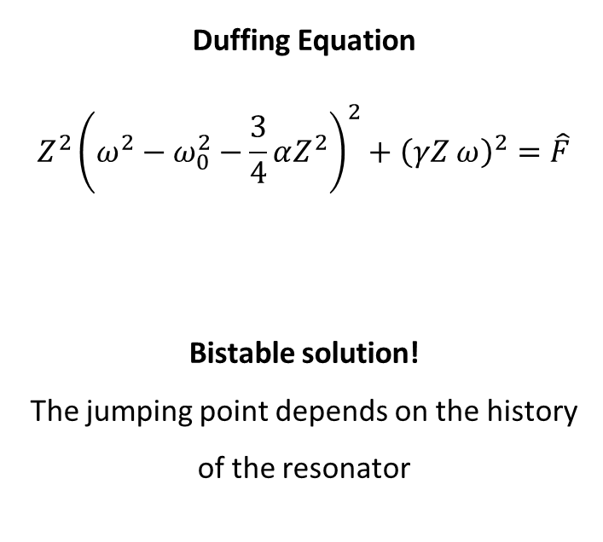
Duffing Oscillator
Duffing Equation
$$Z^{2}{\left(ω^{2}−ω_{0}^{2}−\frac{3}{4}αZ^{2}\right)}^{2}+{\left(γZ ω\right)}^{2}=\hat{F}$$
Bistable solution!
The jumping point depends on the history of the resonator

Slide 9
Low-temperature scanning NW setup

Slide 10
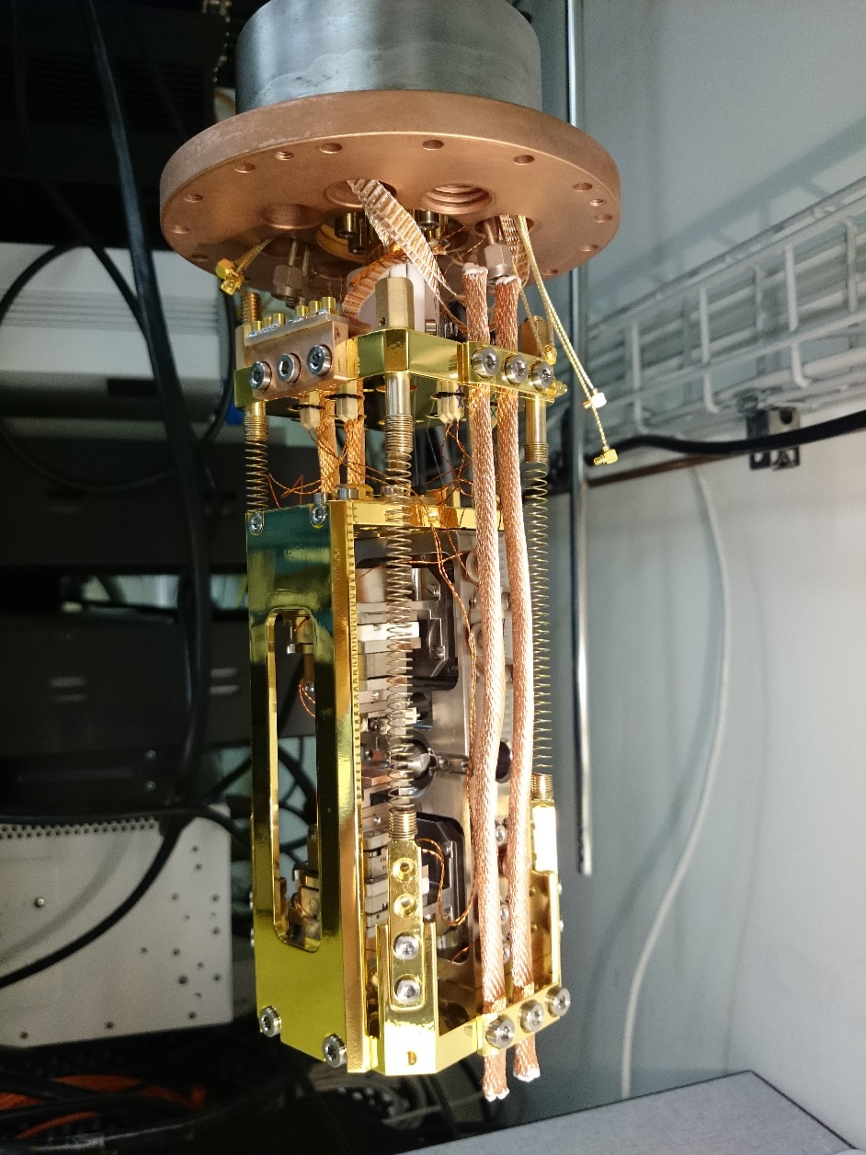
Low-temperature scanning NW setup

Slide 11
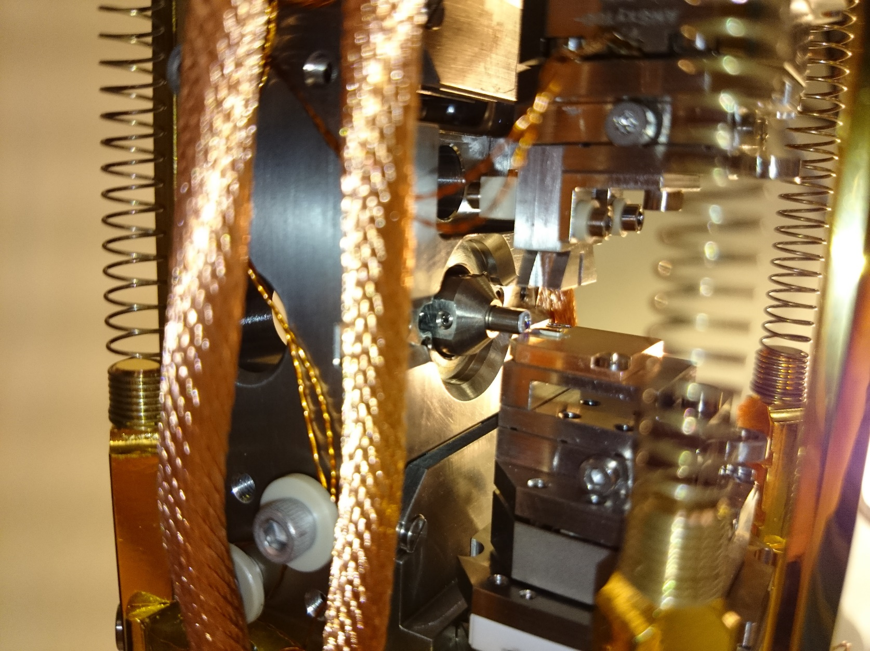
Low-temperature scanning NW setup

Slide 12
Mechanical modes

Slide 13
Nanowire mode doublet

Slide 14
Interferometric detection

Slide 15
Interferometric measurement of NW motion

Slide 16
Interferometric measurement of NW motion

Slide 17
Interferometric measurement of NW motion

Slide 18
Two-mode lateral force microscopy
O. Pfeiffer et al., Phys. Rev. B 65, 161403R (2002)

Slide 19
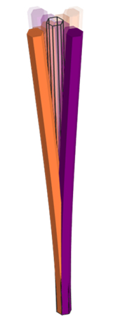
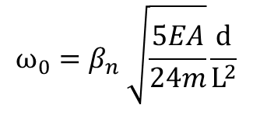
Nanowire mode doublet
MODE I
MODE II
Slightly asymmetric nanowire gives two non-degenerate flexural modes
$$ω_{0}=β_{n} \sqrt{\frac{5EA}{24m}}\frac{d}{L^{2}}$$

Slide 20

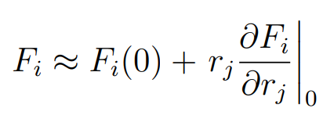
External Force

Slide 21

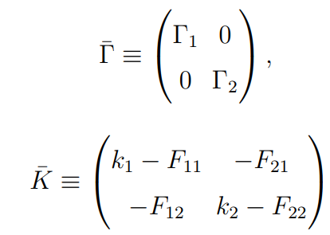
External Force

Slide 22
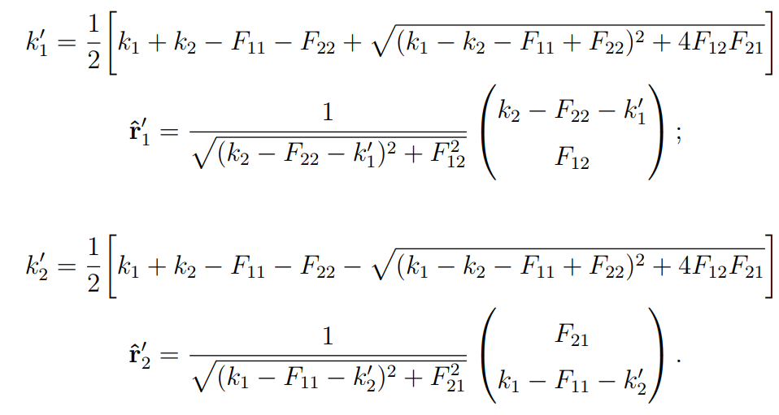
External Force

Slide 23
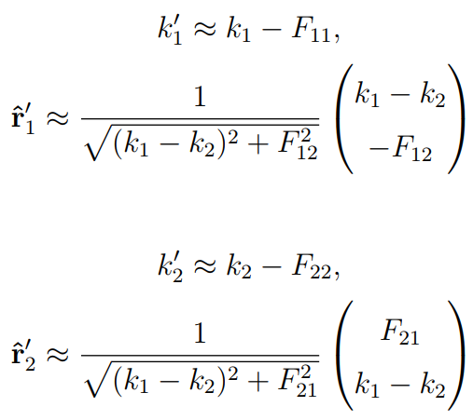
External Force

Slide 24

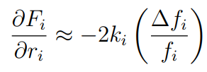



External Force
    $$\frac{∂F_{i}}{∂r_{j}}$$

Slide 25
In-plane spatial force derivatives
NW tip equations of motion:
    $$m{\ddot{r}}_{i}+Γ_{i}{\dot{r}}_{i}+k_{i}r_{i}=F_{th}+F_{i}$$
For small oscillations and $\frac{∂F}{∂r}≪k_{1,2}:$
    $$\frac{∂F_{i}}{∂r_{i}}≈−2k_{i}\frac{∆f_{i}}{f_{i}}$$
    $$\frac{∂F_{i}}{∂r_{j}}≈\left|k_{i}−k_{j}\right|\tan{φ}$$

Slide 26
NW scanning force microscopy
N. Rossi et al., Nat. Nanotechnol. 12, 150 (2017).

Slide 27
NW scanning force microscopy
N. Rossi et al., Nat. Nanotechnol. 12, 150 (2017).

Slide 28
NW scanning force microscopy: Friction
N. Rossi et al., Nat. Nanotechnol. 12, 150 (2017).

Slide 29
Driving with AC voltage
N. Rossi et al., Nat. Nanotechnol. 12, 150 (2017).

Slide 30
AC force fields
N. Rossi et al., Nat. Nanotechnol. 12, 150 (2017).
See also: Mercier de Lépinay et al., Nat. Nanotechnol. 12, 156 (2017).

Slide 31
NWs with magnetic tips
Rossi et al., Nano Lett. 19, 930 (2019).
Notes:
And the NWs themselves have equally excellent mechanical properties, with forces sensitivities in the few aN/sqrtHz range at 4 K.
Of course there are also other ways to obtain magnetic NW sensors: one of these is Focussed electron beam induced deposition.

Slide 32
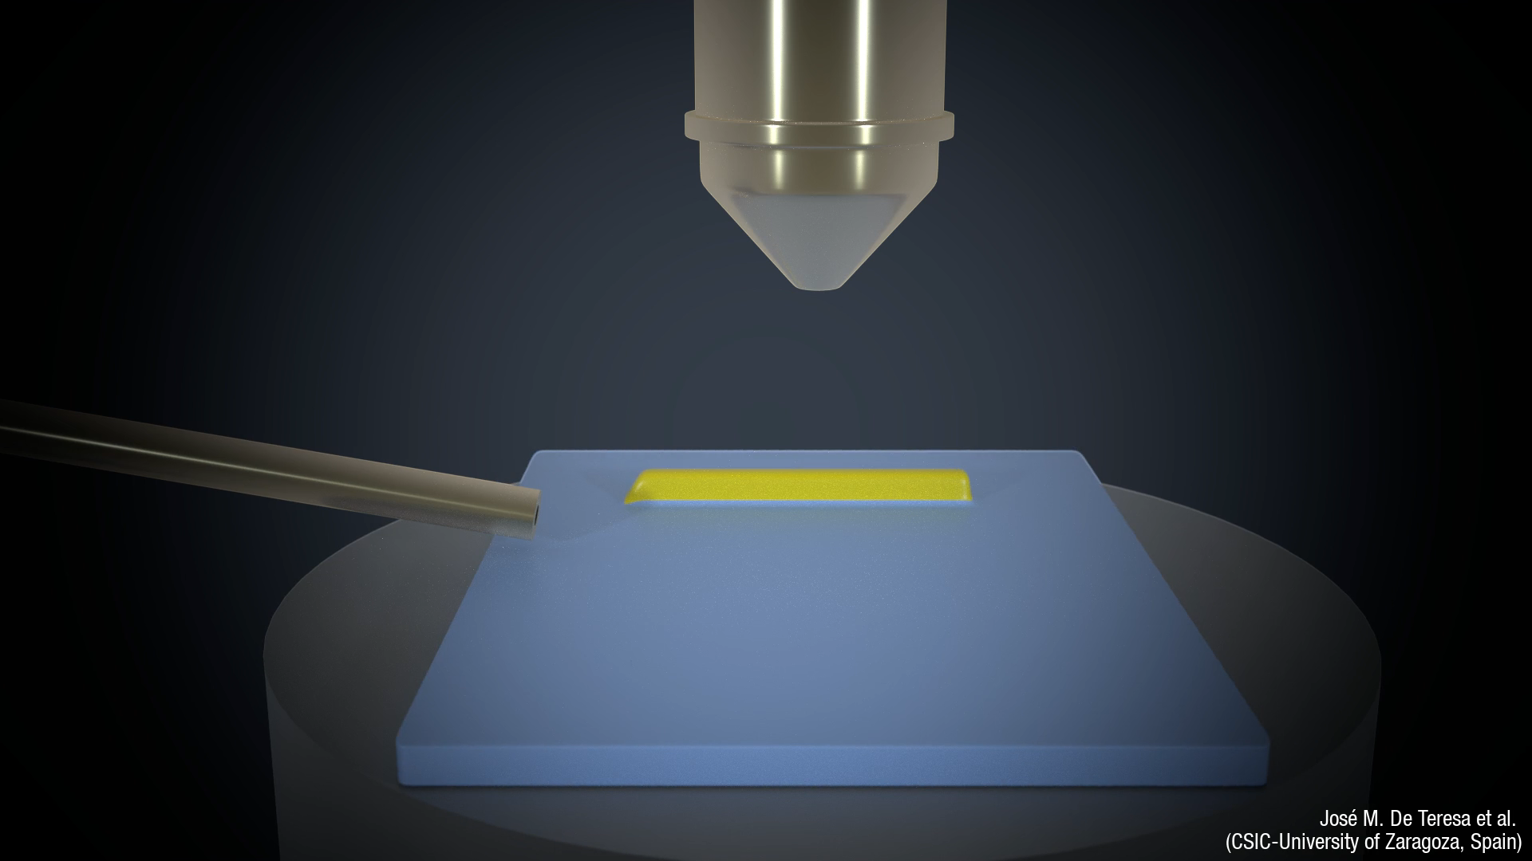
Fully magnetic NWs
De Teresa et al., J. Phys. D: Appl. Phys. 49, 243003 (2016).
Notes:
This method allows for the directed growth of mettalic, superconducting, and even magnetic nanostructures using a focussed electron beam. As you can see here these structures are formed by the catalyzing effect of the electron beam on a precursor gas. The structures can be fully 3D and they can be grown on all kinds of substrates, including non-planar ones, like the tip of this cantilever.

Slide 33
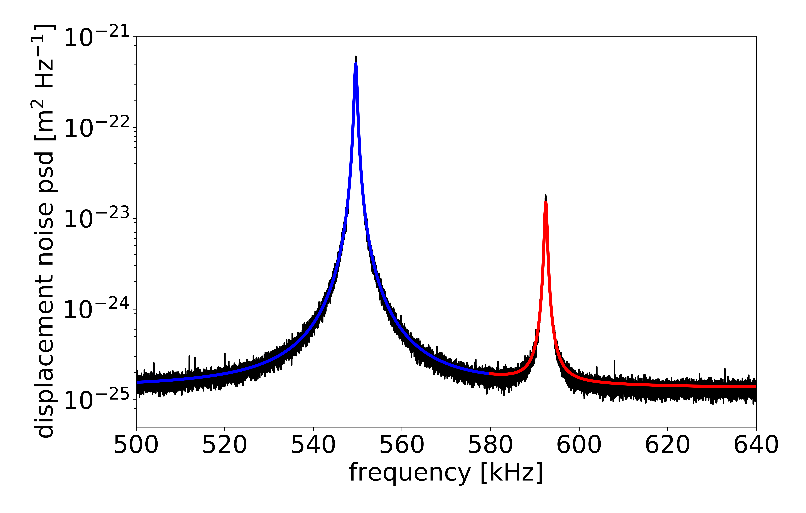
Fully magnetic NWs
T = 4.2 K
10 µm length, 100 nm diameter
Q ≈ 2000
k ≈ 1 mN/m
m_{eff} ≈ 200 fg
F_{min} ≈ 25 aN/Hz^{1/2}
Mattiat et al., Phys. Rev. Appl. 13, 044043 (2020).
Notes:
Surprisingly, these amorphous, fully magnetic NWs, which can be extremely sharp (down to 10s of nms), are of very good mechanical quality. At 4 K they show force sensitivities only slightly worse than their MBE-grown counterparts. These may actually make for the most promising types of sensors, especially because of theor small size and the ability of FEBID to grow wires nearly anywhere and on any substrate, flat or not.

Slide 34
Quantifying sensitivity
Rossi et al., Nano Lett. 19, 930 (2019).
Notes:
In recent experiments, we’ve characterized the magnetic properties of both these types of NWs and their sensivitity as magnetic scanning probes. The way that we quantify sensitivity is to produce a known magnetic field pattern, using a flowing current, and look at its effect on the NW motion. Here, we reduce the field, by reducing the flowing current, until we come to the sensitivity limit of the NW transducer.

Slide 35
Quantifying sensitivity
MBE-grown MnAs-tipped NWs
FEBID-grown Co NWs
+
-
+
-
F_{min} = 4 aN/(Hz)^{1/2}
At 250 nm spacing:
dB/dx_{min} = 11 mT/m(Hz)^{1/2}
F_{min} = 25 aN/(Hz)^{1/2}
At 200 nm spacing:
B_{min} = 3 nT/(Hz)^{1/2}
Rossi et al., Nano Lett. 19, 930 (2019).
Mattiat et al., Phys. Rev. Appl. 13, 044043 (2020).
Notes:
What we find, is that the two types of NWs, which have similar force sensitivities interact with the field in different ways. The first one, because it essentially contains a magnetic dipole at its tip reacts to spatial magnetic field gradients. While the second, beause it is fully magnetic and is therefore an extended dipole, reacts to the sample’s magnetic field. For our experiments, we can extract corresponding sensitivities.

Slide 36
Quantifying sensitivity
MBE-grown MnAs-tipped NWs
FEBID-grown Co NWs
250 nm tip diameter
At 250 nm spacing:
M_{min} = 50 µ_{B}/(Hz)^{1/2}
Φ_{min} = 1 µΦ₀ /(Hz)^{1/2}
I_{min} = 10 nA /(Hz)^{1/2}
100 nm tip diameter
At 100 nm spacing:
M_{min} = 60 µ_{B}/(Hz)^{1/2}
Φ_{min} = 6 µΦ₀ /(Hz)^{1/2}
I_{min} = 8 nA /(Hz)^{1/2}
Kirtley, Rep. Prog. Phys. 73, 126501 (2010)
Notes:
Ultimately, to understand what this means, we have to put this in terms of sensitivity to different types of magnetic field sources, i.e. Magnetic moments in terms of Bohr magnetons (or electron spins), flux quanta (for superconducting vortices), or Amperes for lines of current. As you can seen both of these sensors, but especially the FEBID NWs are combine extreme sensitivity with the possibility of high special resolution, given essentially by the tip diameter and tip-sample spacing.

Slide 37
NW MFM
Py
1 µm
Mattiat et al., Phys. Rev. Appl. 13, 044043 (2020).
Notes:
In fact, here we show initial NW MFM images made with an FEBID NW over a permalloy disc in a vortec state. We can see in the frequency shift data, that the NW shows the presence of the vortex texture in the disc and roughly matches what is expected from micromagnetic simulations. So while work is ongoing, these sensors – despite their compleley classical nature are already showing their potential usefulness in revealing extremely subtle magnetic patterns.

