Slide 1
Introduction to Nanomechanics
(Fall 2026)
22774-01
16.09.2026
Prof. Martino Poggio
University of Basel
poggiolab.unibas.ch
Notes:
MRFM T1 w/ reference to Daniel – explain
cant & SQUID magnetometry: Ni, CoFeB, Py, Skyrmions
new force sensors: NWs
cite Raffi, Olivier
non-linear & AFM results
QD coupling – Q Pigtail

Slide 2
Preliminary Logistics and Introduction
Course outline
Expectations
What is nanomechanics?
Why study nanomechanics?

Slide 3
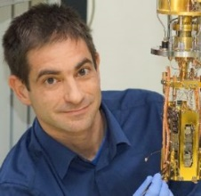




People
Course Leader/Lectures:
  Prof. Martino Poggio
Teaching Assistants/Exercises:
  Dr. Dávid Hovančík
  Dr. Lorena Niggli
  Dr. Lukas Schneider
  Loris Durante

Slide 4
Format and Requirements
Language: English
Prerequisites: Physics III; course-work in solid- state physics and statistical mechanics
Lectures: 10-12 on Wed. (16.09-16.12.2026), 1.09
Exercise Sessions: 11-12 on Tue. (29.09-15.12.2026)
Assignments: exercises, reading, 1 required paper presentation
Final Exam: oral
Grading: 1.0-6.0 based on exam

Slide 5
Books
Foundations of Nanomechanics, A. N. Cleland (Springer, 2003)
Fundamentals of Nanomechanical Resonators, S. Schmid, L. G. Villanueva, M. L. Roukes (Springer, 2016)
Fundamentals of Statistical and Thermal Physics, F. Reif (McGraw-Hill, 1965)
Original papers from Nature, Science, Physical Review Letters, Applied Physics Letters, Review of Scientific Instruments, Physics Today, etc.

Slide 6
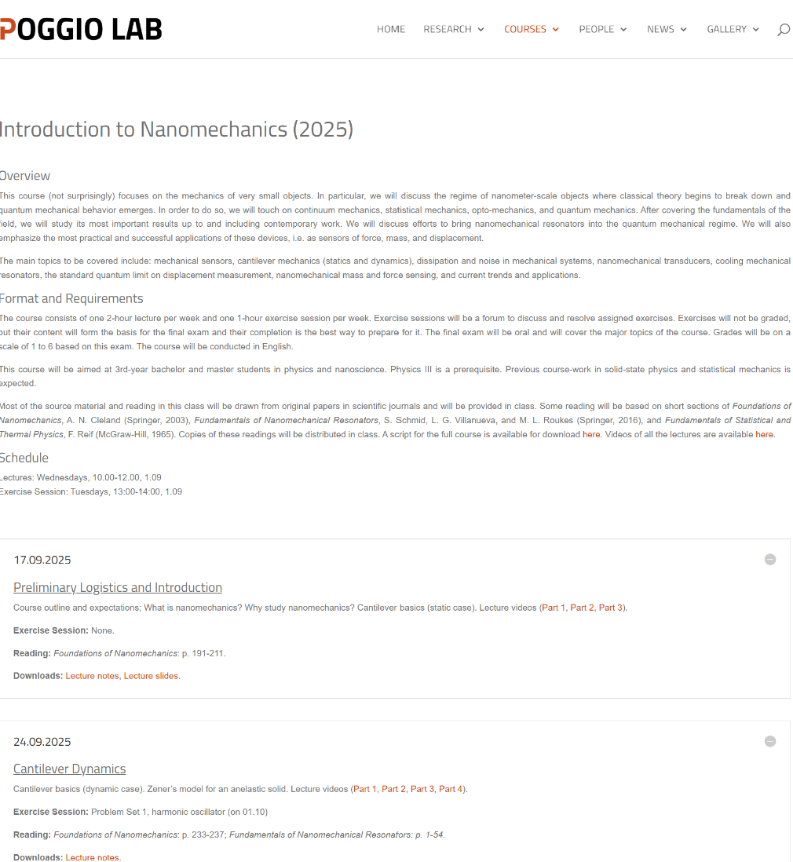
Website
https://poggiolab.unibas.ch/courses/introduction-to-nanomechanics-fall-2025/
Overview
Format and Requirements
Schedule
  Lecture content
  Reading
  Downloads

Slide 7


Slide 8


Slide 9


Slide 10
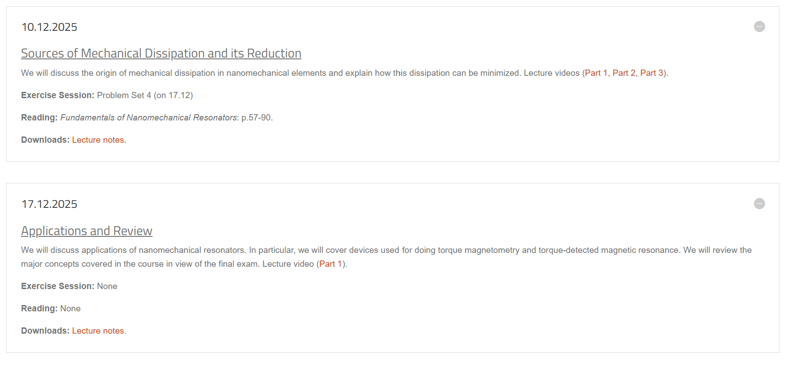

Slide 11
Questions?

Slide 12
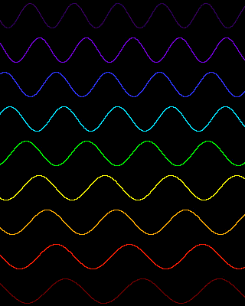

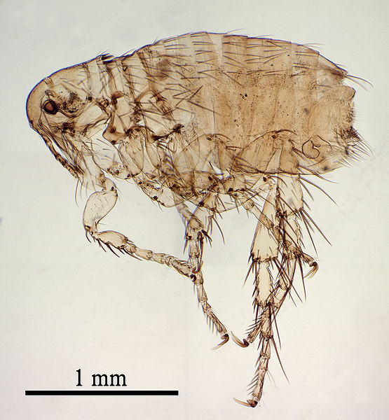
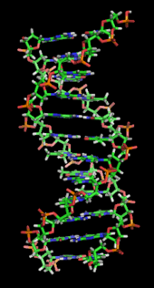
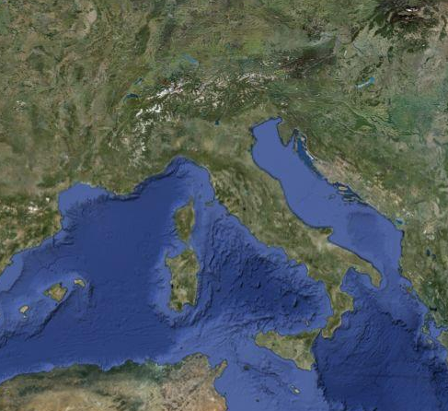
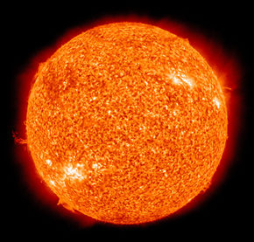
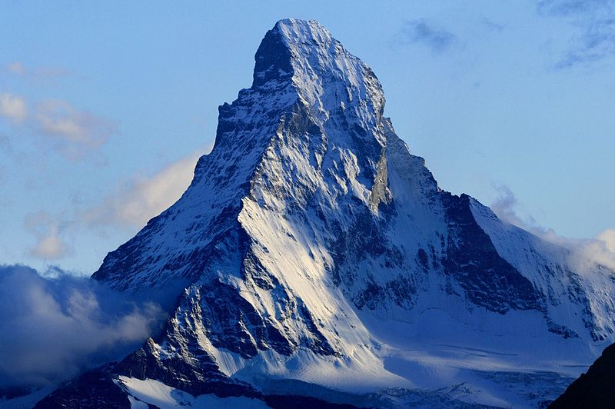
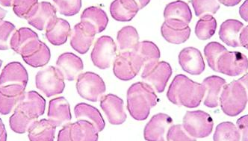
Size scales
Visible light
0.4 - 0.8 μm
DNA
2.5 nm
Matterhorn
1.0 km
Basel
Red blood cell
10 μm
H atom
50 pm
The sun
1.4 Gm
Proton
1.75 fm
1.2 Mm
Average man
1.75 m
Lecce
BIG
Dog flea
2 mm
small
10⁹ m
10⁶ m
10³ m
10⁰ m
10⁻³ m
10⁻⁶ m
10⁻⁹ m
10⁻¹² m
10⁻¹⁵ m
Gm
Mm
km
m
mm
μm
nm
pm
fm

Slide 13
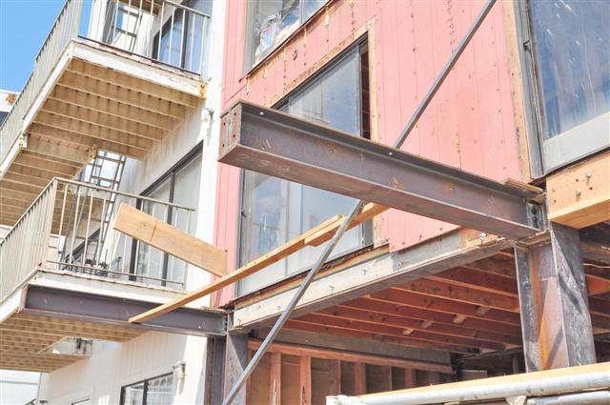
(Macro)mechanics
Nanomechanics
10⁹ m
10⁶ m
10³ m
10⁰ m
10⁻³ m
10⁻⁶ m
10⁻⁹ m
10⁻¹² m
10⁻¹⁵ m
Gm
Mm
km
m
mm
μm
nm
pm
fm

Slide 14
How is nanomechanics different than (macro)mechanics?
Thermal fluctuations significantly affect the motion of small bodies
Quantum mechanical fluctuations affect the motion of even smaller bodies
Notes:
Smoke Particle Demonstration

Slide 15
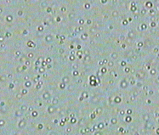
Brownian motion
Fat droplets suspended in milk through a 40x objective.
The droplets are 0.5 - 3.0 μm in size.

Slide 16
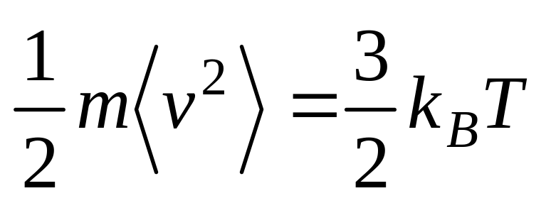
Thermal energy
Particle mass
Boltzmann constant
Mean square velocity
Temperature

Slide 17
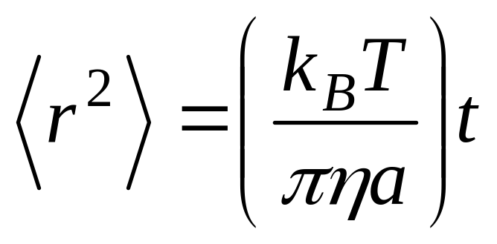
Brownian motion
Mean square displacement
(a measure of the size of the fluctuations)
Elapsed time
Particle radius
Viscosity of medium

Slide 18

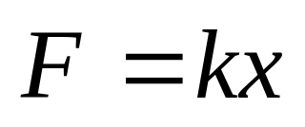
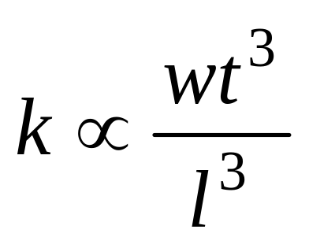
Cantilever
F
x
Spring constant

Slide 19
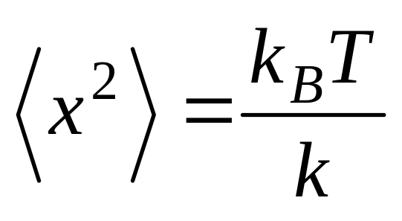
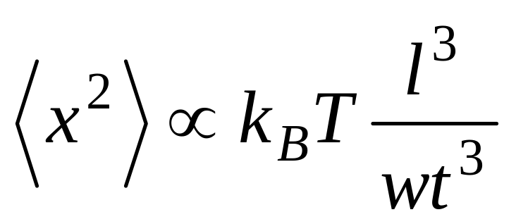
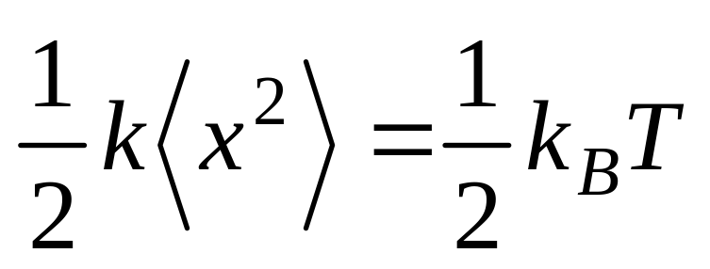
Cantilever
F
x
Mean square displacement

Slide 20
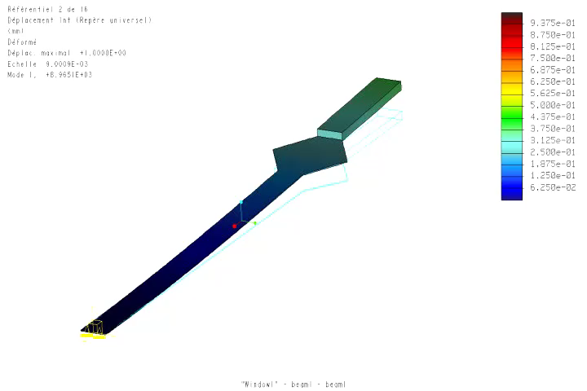
1st mode

Slide 21
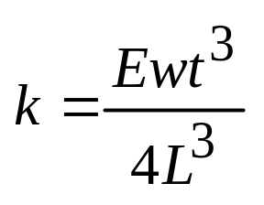
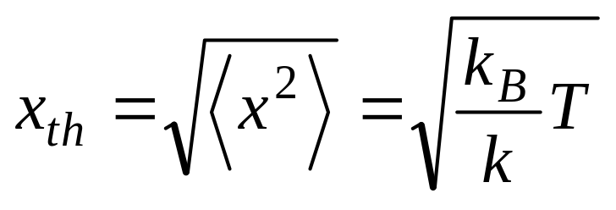
(Macro)mechanics
L = 2 m
w = 100 mm
t = 50 mm
E_{SS} = 200 GPa
x_{th} = 0.2 pm
for T = 300 K
k = 78 kΝ/m

Slide 22
Nanomechanics
L = 120 μm
w = 3 μm
t = 100 nm
E_{Si} = 169 GPa
x_{th} = 8 nm
for T = 300 K
k = 73 μΝ/m

Slide 23
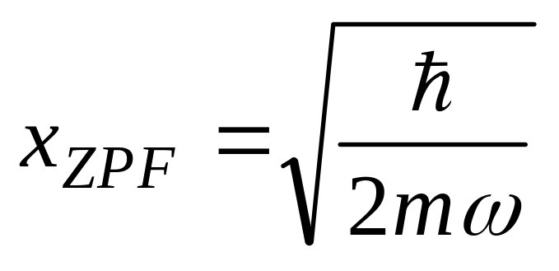
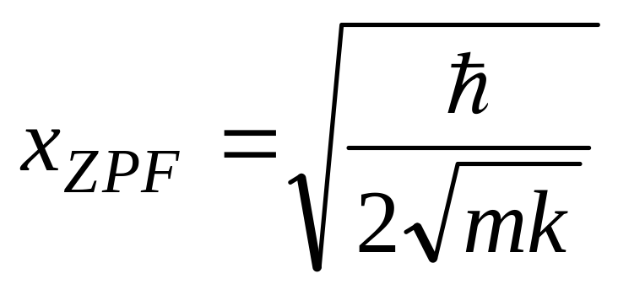
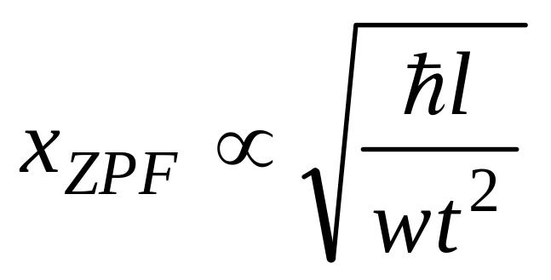
Quantum fluctuations
Zero point fluctuations
Planck constant
Resonant frequency
Mass

Slide 24
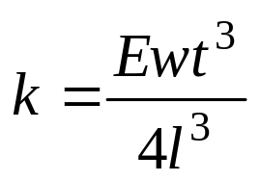
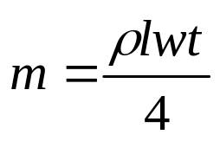

(Macro)mechanics
l = 2 m
w = 100 mm
t = 50 mm
E_{SS} = 200 Gpa
ρ = 7.85 g/cm³
x_{ZPF} = 0.2 am
x_{ZPF} = 0.2 x 10⁻¹⁸ m
k = 78 kΝ/m
m = 20 kg

Slide 25
Nanomechanics
L = 120 μm
w = 3 μm
t = 100 nm
E_{Si} = 169 Gpa
ρ = 2.3 g/cm³
x_{ZPF} = 0.2 pm
x_{ZPF} = 0.2 x 10⁻¹² m
k = 73 μΝ/m
m = 20 pg

Slide 26
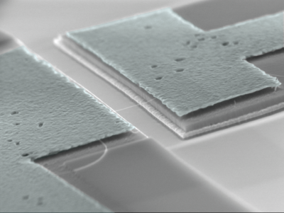
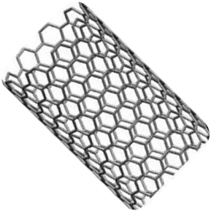
Carbon nanotube
m = 10⁻²¹ kg
ω = 2π x 500 MHz
x_{ZPF} = 4 pm
x_{ZPF} = 4 x 10⁻¹² m

Slide 27
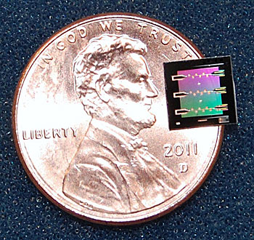
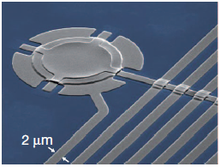
Quantum fluctuations of a drum
Lehnert, 2011

Slide 28
Why study nanomechanics?
Link between classical mechanics and statistical mechanics
Link between classical mechanics and quantum mechanics
Smaller sensors are more sensitive

Slide 29
What is nanomechanics good for?
Smaller sensors are more sensitive!
  Measurement of displacement
  Measurement of mass
  Measurement of force
  Measurement of charge
  Measurement of magnetic moment

Slide 30
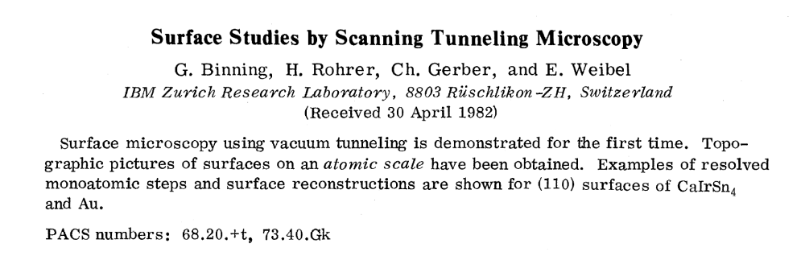
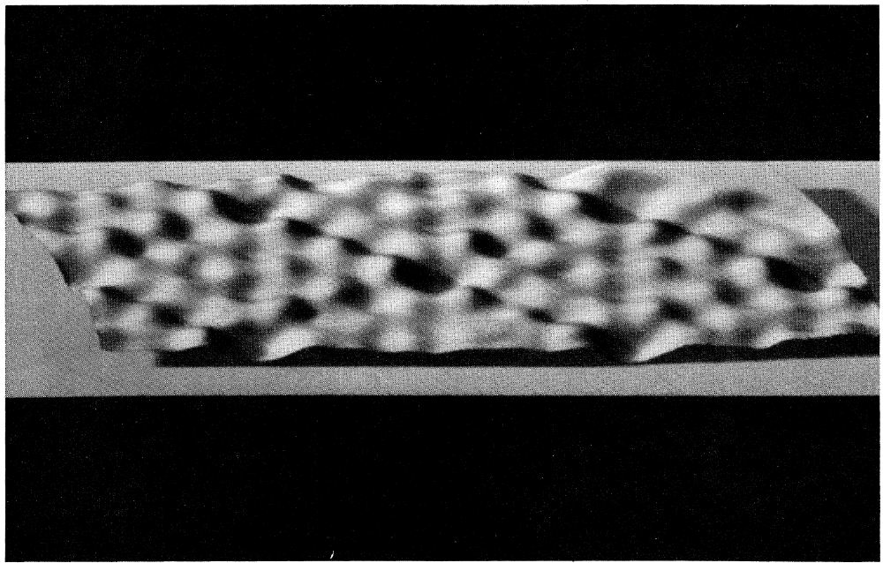
Notes:
In the early 1980s the introduction of the STM led to the first real-space images of individual surface atoms, which you can see here. This breakthrough kick-started a whole series of new and extremely useful activities in scanning probe microscopy, i.e. techniques in which images are formed by scanning a physical probe across a sample and measuring its response.

Slide 31
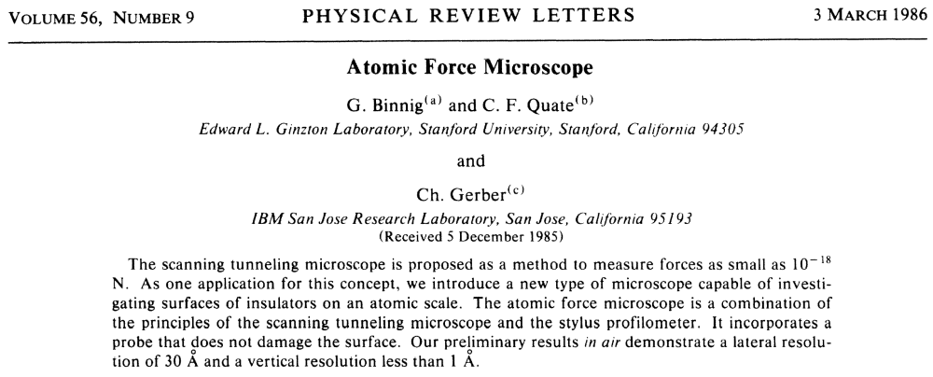
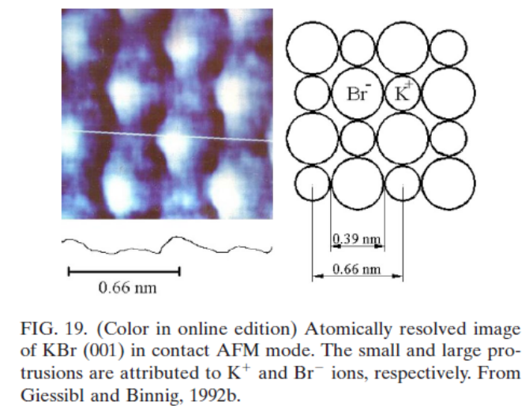
Notes:
Shortly after the invention of the STM, came the invention of the AFM by some of the same people. In fact, Christoph Gerber, who contributed to both works continues to work in our department in Basel and recently shared the Kavli prize with Cal Quate for his work on developing the AFM.
The AFM became perhaps the single most important and widely applied tool for nanometer scale imaging. Its used in physics, biology, chemistry, and materials science labs all over the world… and it requires no logical qubits ;-) In part, the boom in nanometer-scale science and technology that we’ve been living through in the last 30 years can be traced back to the spectacular success and excitement created by the AFM and STM.
In the intervening years all kinds of SPM were developed including:
KPFM, MFM, MRFM, NSOM, SHM, SGM,
Some subset of these scanning probes are based on quantum sensors: SSM, SSET, SQDM, SNVCM

Slide 32
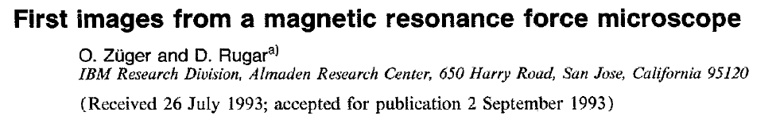
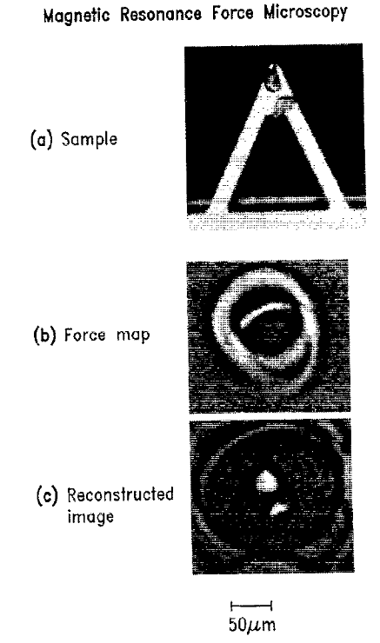
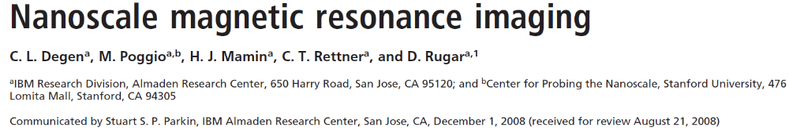
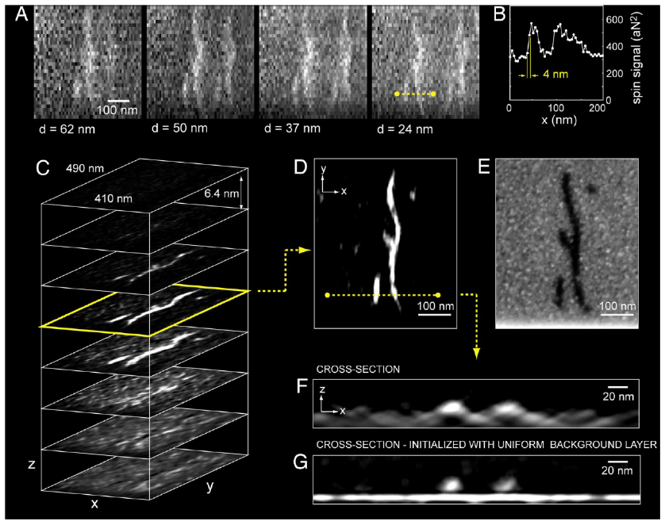

Slide 33
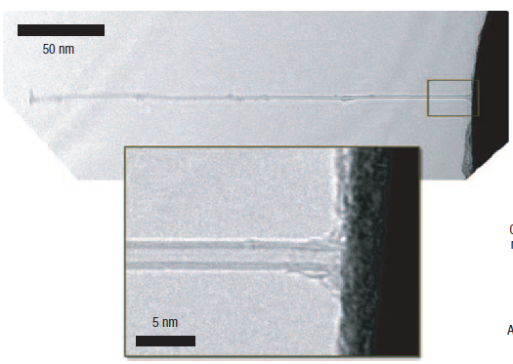
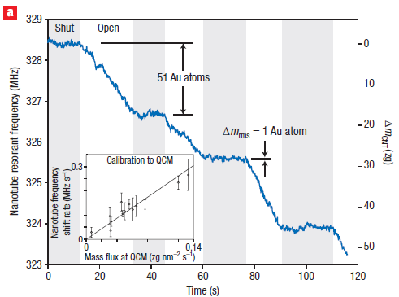
Weighing a single atom
Zettl, 2008

Slide 34
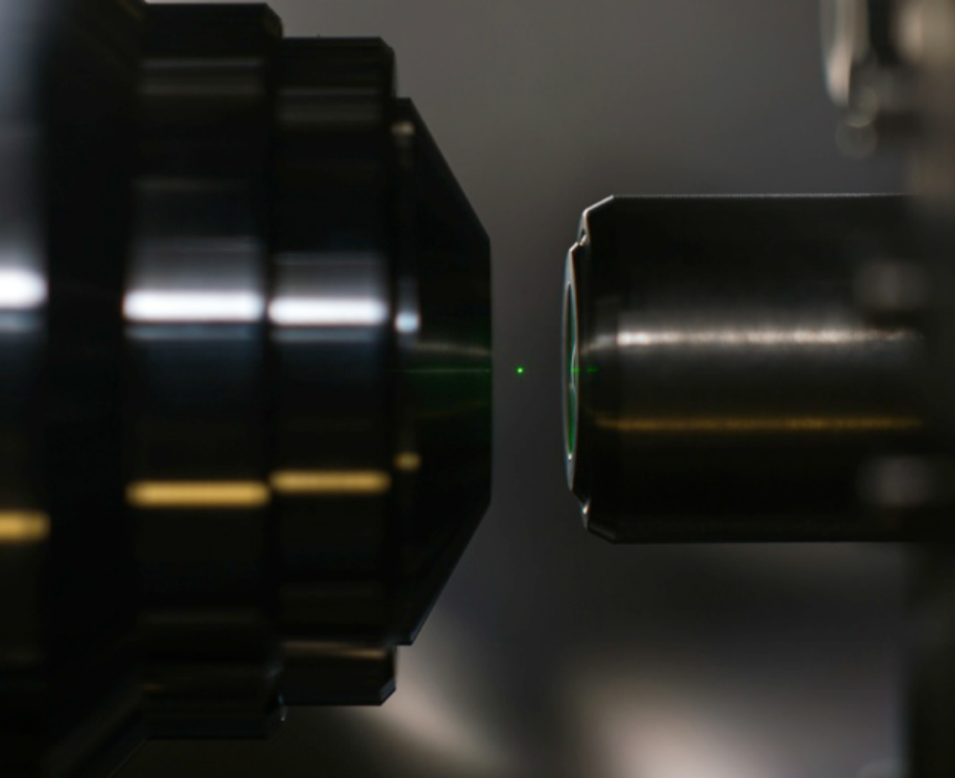
Control of levitated nanoparticles
21.10.2016
Notes:
Si cantilever length 120µm (paddle 95µm, mass loaded 18µm) width 3µm-4µm (paddle 10µm, mass loaded 4µm) thickness 111nm-148nm (mass loaded 1.5µm)
ultrasensitive, thermally limited detector (=force sensor) = measure only forces that are larger than thermal force noise (which we know from the fluctuation(S_F)-dissipation(Gamma) theorem)
what makes a good sensor w/ better sensitivity? → ruled by temp T and mech properties Gamma

Slide 35
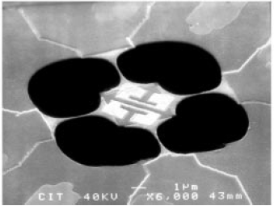
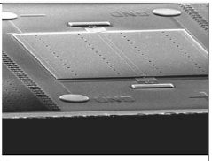
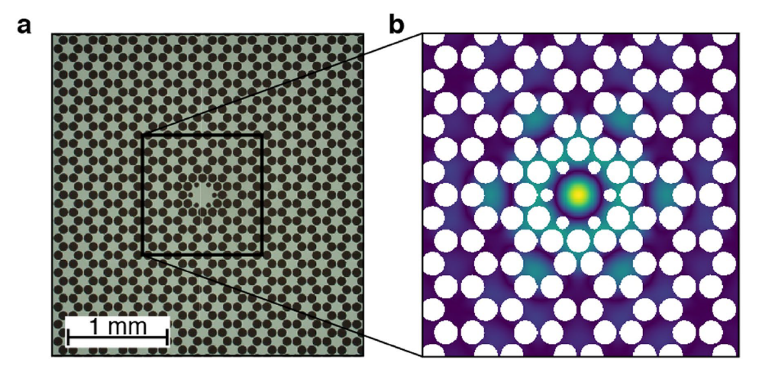
Quantum effects
Quantum of Thermal Conductance
Casimir Force Measurement
Schwab et al., 2000
Decca, 2003
Quantum control of mechanical motion
Rossi, 2018

